Slide 1
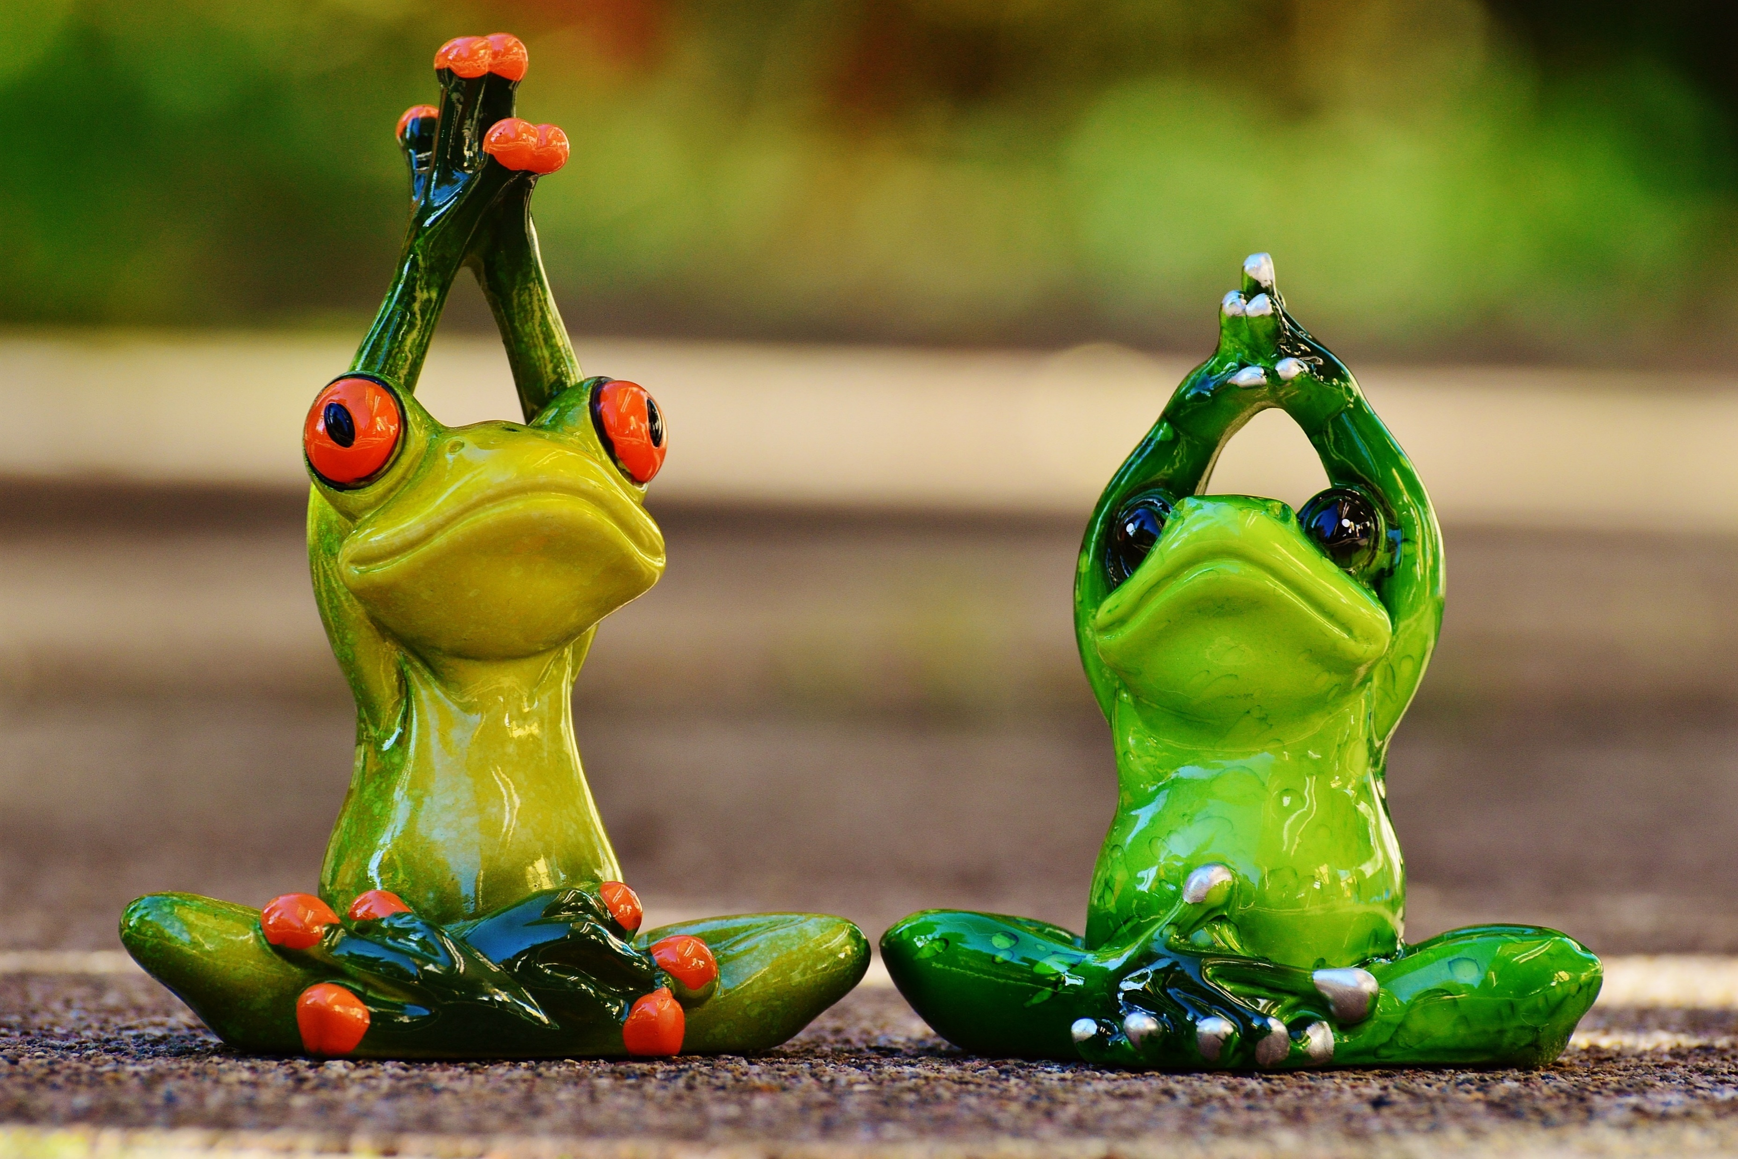
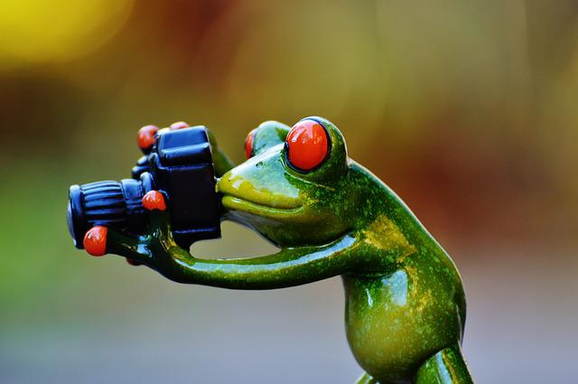
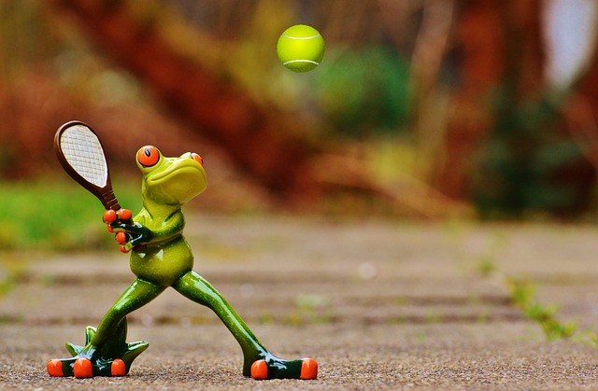

Automated Image captioning
Group 3
Sujatha Kancharla
Monica Nukarapu
Suhail Pasha
Yoga for ….
Trick Photography…
Chaitanya Harkara
Mentor
Nayan Jha
Tennis at …
Tennis at …
Make money when…
Tennis at …

Slide 2
Agenda
Problem Statement
Understanding the problem
References and options
Architecture
Base Model (Already discussed)
InceptionV3 + LSTM
ResNet50 +LSTM
Attention + LSTM (Already discussed)
VGG16 + Attention
Resnet50 + Attention
Transformers (Updated as per suggestion)
InceptionV3 + Transformers
Resnet50 + Transformers
Solution - Model
Architecture
Results
UI Integration & Deployment
Demo
Challenges and Mitigation
Inferences

Slide 3
Understanding the problem
Problem Statement
Automated Image Captioning using AIML
Automated Image captioning involves in creating an automated caption for an Image by deriving the best context of the contents of the image.
Broadly the solution should
Identify multiple objects within the image
Derive the relationship between the objects in the image based on their attributes
Derive the caption based on the derived context of the image in Natural language (English)
Key Requirements
Tools : Natural Language Toolkit, TensorFlow, PyTorch, Keras
Deployments: FastAPI, Cloud Application Platform | Heroku, Streamlit, Cloud Computing, Hosting Services, and APIs | Google Cloud
Technology

Slide 4
Architectures referred and their key features
Neural Image caption generator
Automated image captioning using Resnet50 and LSTM with soft attention
Attention is all you need
LSTM (Option1) | Attention + LSTM(Option2) | Transformers Architecture((Option3)
To avoid potential Vanishing or exploding gradient problem in RNN Challenges with long range sequence processing in RNN LSTM Memorize the Cell state from previous steps and include multiple gates to Forget Cell state or Ignore Input, Select output in each time step Entire image is sent as input for each word to decoder | Attention model will learn to focus on specific features of Image which are related to the Predictions rather than processing the entire image It includes building attention weights to learn specific part of image for each word Features derived using these attention weights are passed to LSTM Attention is a boosting mechanism to improve the accuracy of model through better learning of input images | Embedding and Position encoding is performed to build a context Entire sentence is processed instead of each word sequentially Attention weights are generated through self Attention layer processed multiple times (configured) in parallel More distinct features of the image related to the word can be learnt with Parallel processing
A solution based on Encoder Decoder architecture is built using all three Architecture

Slide 5
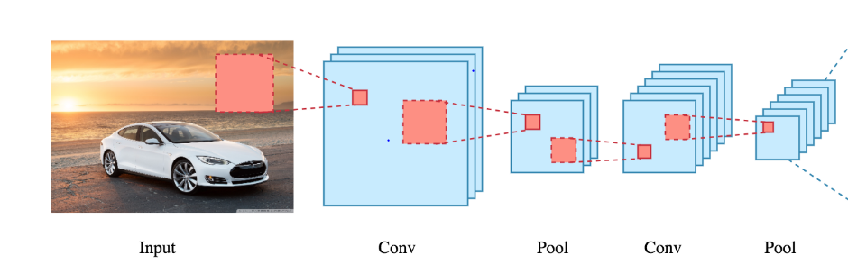
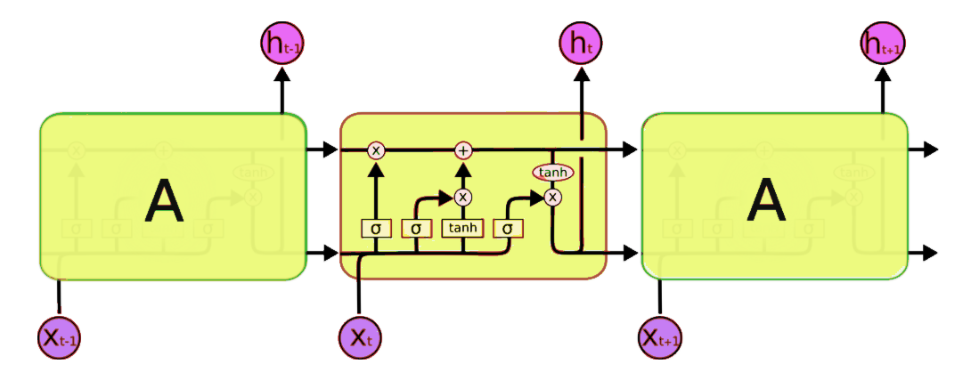
Base model – Automatic Image Captioning Based on Resnet50/InceptionV3 and LSTM
Word
Word
Word
Caption
Features
Resent50/InceptionV3 - CNN(Encoder)
LSTM(Decoder)
Reference
NIC is based end-to-end on a neural network consisting of a vision CNN followed by a language generating LSTM
Inspiration
Text Transitions of LSTM
CNN Encoders converting Text to Rich Vector representation
LSTM Decoders generating Target Sentence
Summary
CNN as Encoder for providing rich Vector representation of image (last hidden layer from a pretrained classifier)
LSTM Decoders generating Target Sentence

Slide 6
Base model- Implementation Encoder (InceptionV3)+ LSTM
Pre- Processing
Feature Engineering
Pick Model & Hyper Parameters
Model Training and Optimization
Evaluate Model
Deploy on Server
Integrate and Test
Read the Annotations and Image data mapping from Flickr8k_Text to build Input – Image and Corresponding Caption(s)
Image Feature extraction using pretrained InceptionV3 to a 1D Vector (299,299) to (2048,)
Dictionary based on Glove 200 attribute word embedding from Stanford.edu
InceptionV3 - 1D - ( 2048,)
Keras/Pytorch based Model
LSTM
Cross Entropy Loss Function , Adam
Hyper parameters – determined Iteratively
Hyper parameters Learning Rate , Epochs, Batch Size, Drop out derived iteratively
X train = Image (6000)
Y Train = Caption derived from Pre-processing and feature engineering
1000 images (dev) and captions
1000 images (Test) and captions
Captions and ratings provided in Flickr8k_Text
Rating Standard BLEU
Compare the outcome from LSTM Vs Rated Image caption data using BLEU rating standard
FastAPI
Cloud Computing
Hosting Services
API
Test model using 250 test images
Check the rating of the Test images
User Input
Test the caption generated for image as User input provided on a Web page
Key Steps
Inputs
Files
Flickr8k.token
Flickr_8k.trainImages
InceptionV3 Model
LSTM
Glove Word Embedding (200)
Optimizer
LSTM Implementation
Flickr8k_Text
Flickr8k_Text
BLEU
BLEU
Flickr8k_Text
BLEU

Slide 7
Base model- Implementation using ResNet50 + LSTM
Pre- Processing
Feature Engineering
Pick Model & Hyper Parameters
Model Training and Optimization
Evaluate Model
Deploy on Server
Integrate and Test
Read the Annotations and Image data mapping from Flickr8k_Text to build Input – Image and Corresponding Caption(s)
Image Feature extraction using pretrained Resnet50 to a 1D Vector (224,224,3) to (2048,)
Dictionary based on Glove 200 attribute word embedding from Stanford.edu
Soft Attention to extract more relevant feature of the image
ResNet50 - 1D -
( 2048,)
Keras/Pytorch based Model
LSTM
Cross Entropy Loss Function , Adam
Hyper parameters – determined Iteratively
Hyper parameters Learning Rate , Epochs, Batch Size, Drop out derived iteratively
X train = Image (6000)
Y Train = Caption derived from Pre-processing and feature engineering
1000 images (dev) and captions
1000 images (Test) and captions
Captions and ratings provided in Flickr8k_Text
Rating Standard BLEU
Compare the outcome from LSTM Vs Rated Image caption data using BLEU rating standard
FastAPI/Heroku
Cloud Computing
Hosting Services
API
Test model using 1000 test images
Check the rating of the Test images
User Input
Test the caption generated for image as User input provided on a Web page
Key Steps
Inputs
Files
Flickr8k.token
Flickr_8k.trainImages
ResNet50 Model
LSTM
Glove word embedding(200)
Optimizer
LSTM Implementation
Flickr8k_Text
Flickr8k_Text
BLEU
BLEU
Flickr8k_Text
BLEU

Slide 8
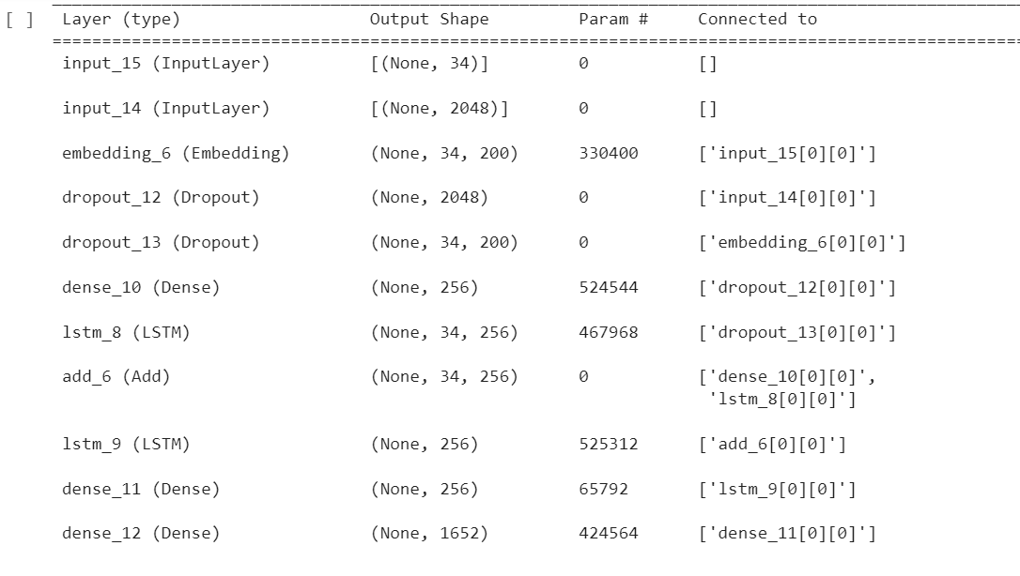
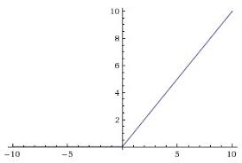
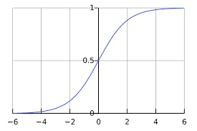
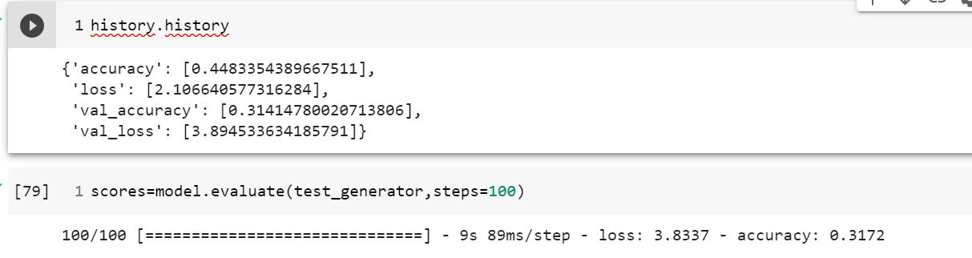
Base model- Implementation using InceptionV3
Encoder(InceptionV3)
Decoder
Flickr8
InceptionV3
Drop out+ Dense
299,299
2048,
256
LSTM(256)
Dense(256)
Dense(1652)
Image
Relu
Word Embedding(Glove)
Loss - Cross Entropy
Optimizer - Adam
Caption Data
Glove Word Embedding
Drop out
Epochs – 45
Learning rate – 0.0001
34 word Max
1652, 200
256
Relu
Softmax
Efficacy Measurement – BLEU ( Trigram)
1652 >10 rep words

Slide 9
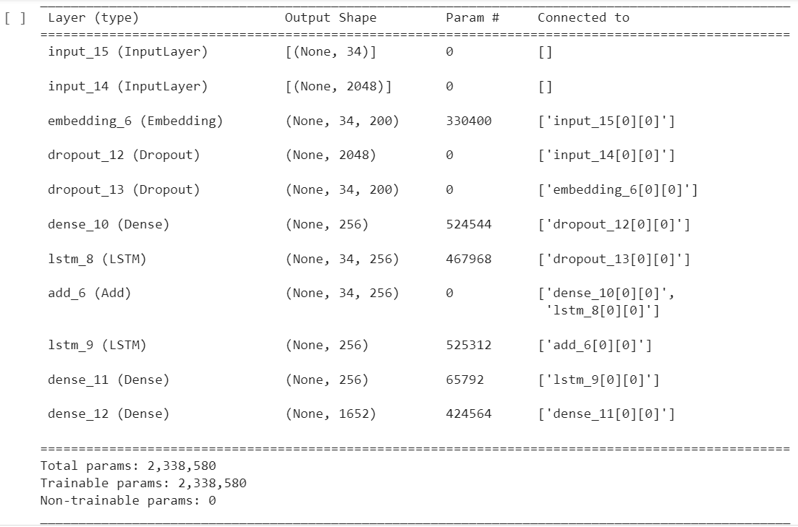
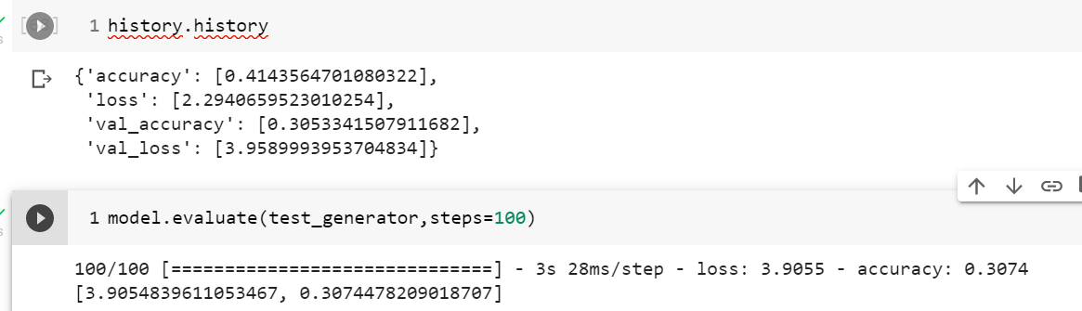
Base model- Implementation using ResNet50
Encoder(ResNet50)
Decoder
Flickr8
Flickr8
Flickr8
ResNet50
ResNet50
ResNet50
Drop out+ Dense
Drop out+ Dense
224,224,3
2048,
256
LSTM(256)
Dense(256)
Dense(1652)
Image
Relu
Word Embedding(Glove)
Loss - Cross Entropy
Optimizer - Adam
Caption Data
Glove Word Embedding
Drop out
Epochs – 45
Learning rate – 0.0001
34 word Max
1652, 200
256
Efficacy Measurement – BLEU ( Trigram)
Relu
Softmax
1652 >10 rep words

Slide 10
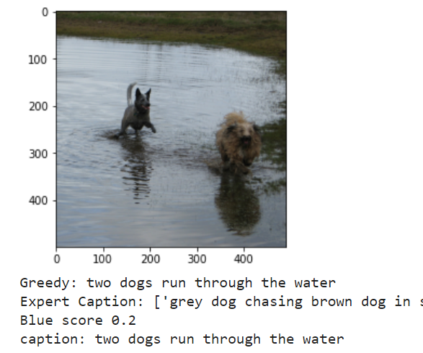
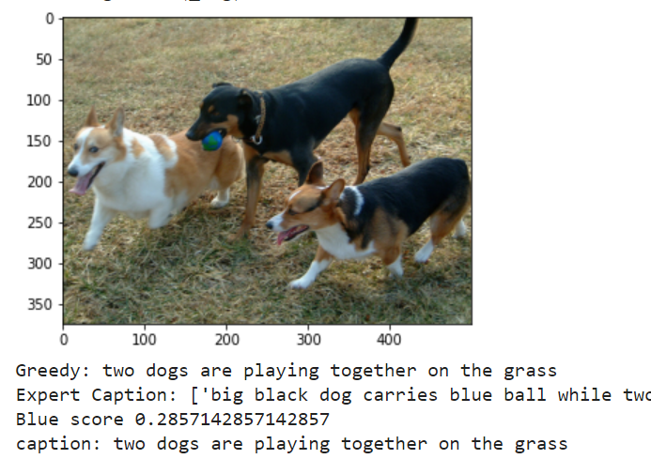
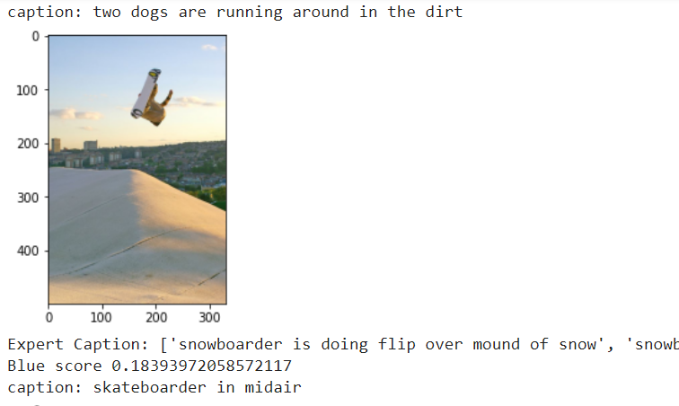
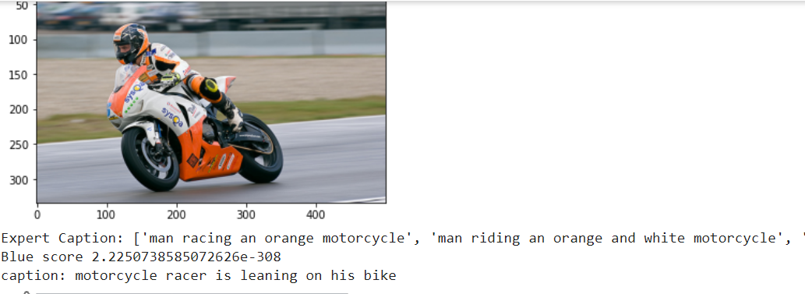
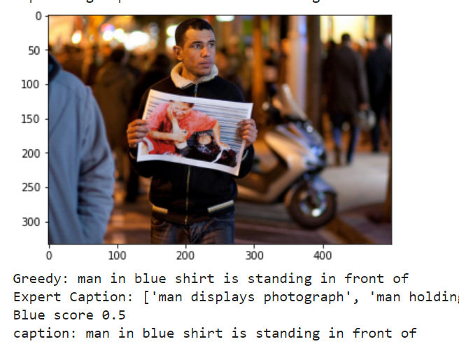
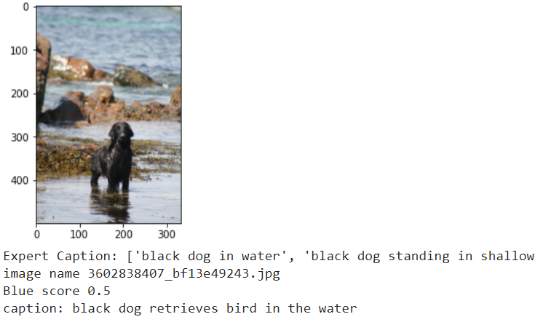
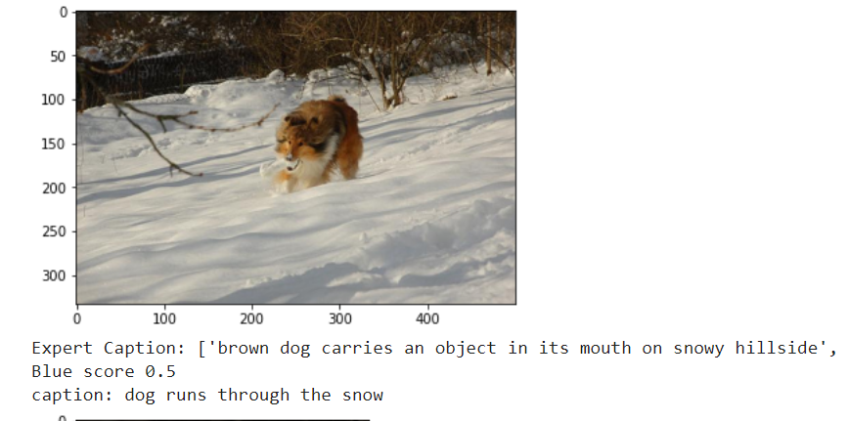
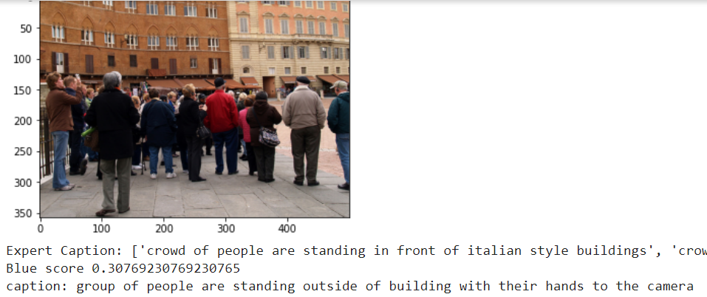
Output captions – Base Model(LSTM)
Inception V3
Resnet50

Slide 11
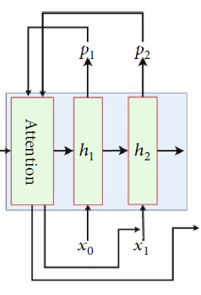
Attention – Automatic Image Captioning Based on ResNet50/VGG16, Attention and LSTM
Caption
Feature vector
ResNet50(Encoder)
LSTM(Decoder)
Reference
AICRL is based end-to-end on a neural network consisting of a RESNET50 CNN followed by a language generating RNN
Inspiration
Adding attention layer on ResNet50 significantly improved the description accuracy
Summary
Extract visual features, which use ResNet50 network as the encoder from the input images
Soft Attention mechanism

Slide 12
Attention - Implementation using Encoder(ResNet50) + Attention + LSTM
Pre- Processing
Feature Engineering
Pick Model & Hyper Parameters
Model Training and Optimization
Evaluate Model
Deploy on Server
Integrate and Test
Read the Annotations and Image data mapping from Flickr8k_Text to build Input – Image and Corresponding Caption(s)
Image Feature extraction using pretrained Resnet50 from input (224,224,3) to (7,7,2048)
Word embedding from using Keras
Soft Attention to extract more weights for feature of the image
Isolated Features vector + Word passed to LSTM
ResNet50 Keras/Pytorch based Model
LSTM
SparseCategoricalCrossentropy, Adam
Hyper parameters Learning Rate , Epochs, Batch Size, Drop out derived iteratively
X train = Image (6000)
Y Train = Caption derived from Pre-processing and feature engineering
1000 Validation images
Captions and ratings provided in Flickr8k_Text
Rating Standard BLEU
Compare the outcome from Attention Vs Rated Image caption data using BLEU rating standard
FastAPI
Google Cloud Computing
Hosting Services
Test model using 250 test images
Check the rating of the Test images
User Input
Test the caption generated for image as User input provided on a Web page
Key Steps
Inputs
Files
Flickr8k.token
Flickr_8k.trainImages
Flickr30
ResNet50 Model
LSTM
Keras Word embedding
Optimizer
LSTM
Flickr8k_Text
Flickr8k_Text
BLEU 1 , BLEU 2 , BLUE 3 , BLUE4
BLEU 1 , BLEU 2 , BLUE 3 , BLUE4
Flickr8k_Text
BLEU 1 , BLEU 2 , BLUE 3 , BLUE4

Slide 13
Attention - Implementation using ResNet50 + LSTM
features
Context
Encoder layer
Flickr Image
Resent50/Inception
Feature Vector
Dense(256)
Attention layer
Dense(512)
Dense(512)
softmax
Attention Weights
(64,49,1)
(224,224,3)
(64,7,7,2048)
(64,7,7,2048)
(64,49,256)
Relu
tanh
Context
Word Embedding
Caption Data
Word Embedding
Word Embedding
Feature with Attention
FC1
FC2
(64, 8329)
(64, 1, 256)
LSTM

Slide 14
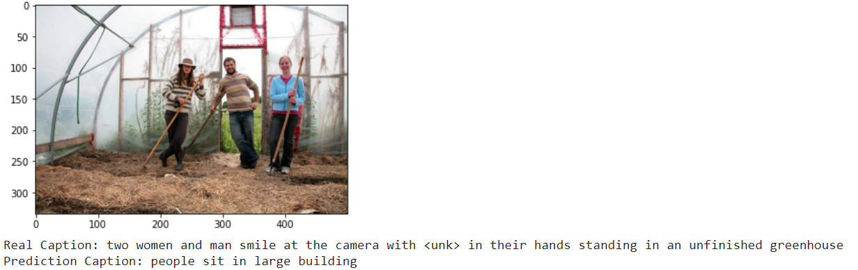
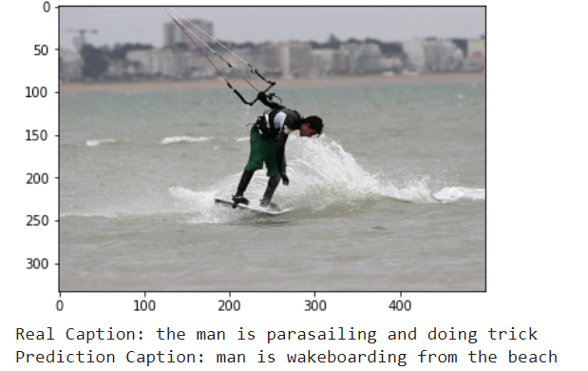
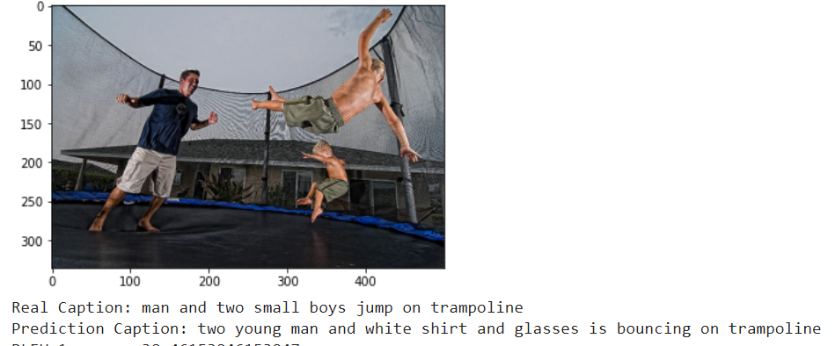
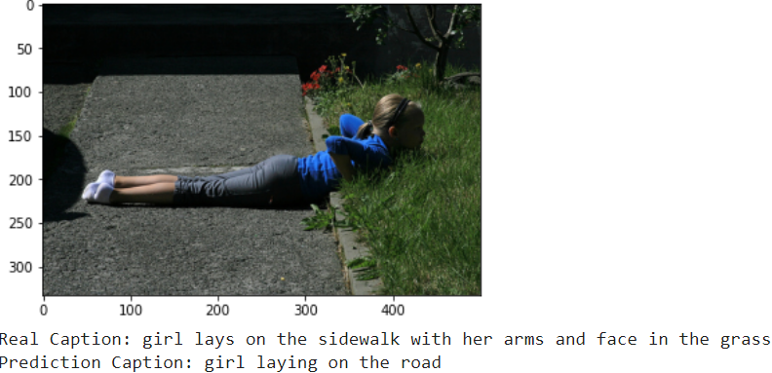
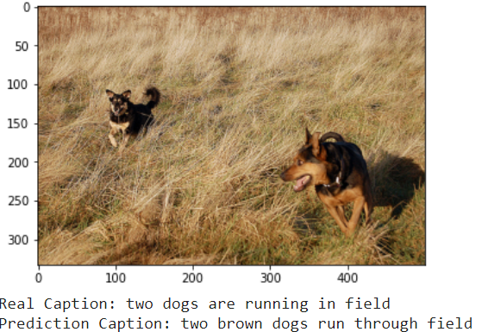
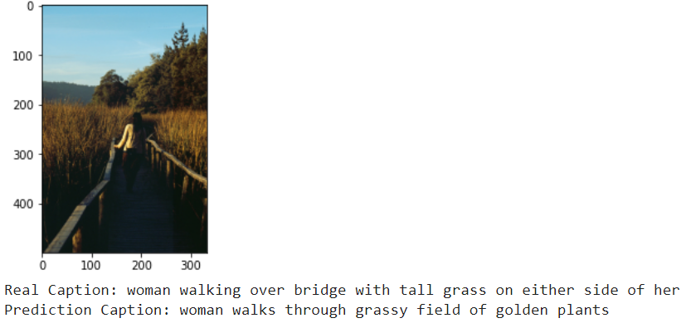
Automated Captions generated- (Attention) + Flickr8 + 70 Epochs
VGG16
Resnet50

Slide 15
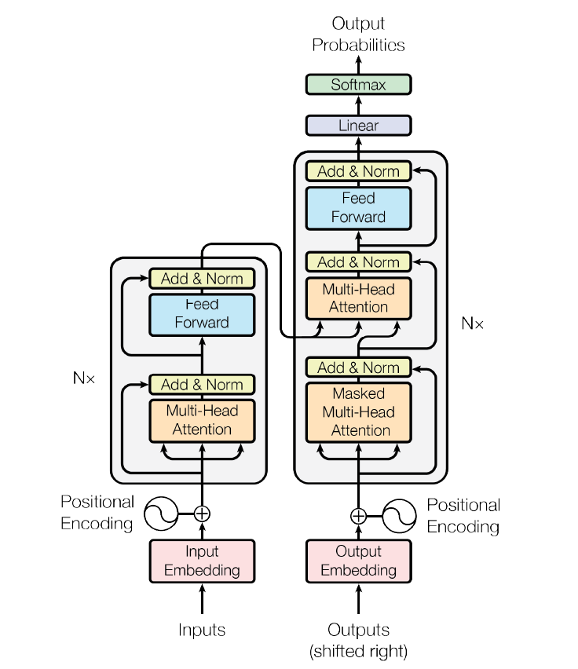
Transformers- Implementation using Encoder(ResNet50) + Transformers
Transformer architecture
Transformer architecture using Multi head attention on Image input
Transformer architecture helps parallelization of sequential data
GPUs are used efficiently processing the multiple words in the sentence

Slide 16
Transformers- Implementation using Encoder(ResNet50/InceptionV3) + Transformers
Pre- Processing
Feature Engineering
Pick Model & Hyper Parameters
Model Training and Optimization
Evaluate Model
Deploy on Server
Integrate and Test
Read the Annotations and Image data mapping from Flickr8k_Text to build Input – Image and Corresponding Caption(s)
Image Feature extraction using pretrained Resnet50 for image input Vector (224,224,3) to (64,49,512)
Word embedding from Keras
Muli head attention
Keras/Pytorch based Model
Feature vectore + position Encoding
Word Embedding + Position Encoding
Mutlihead attention
Transformers
SparseCategoricalCrossentropy, Adam
Hyper parameters – determined Iteratively
Multi Head = 8
Hyper parameters Learning Rate , Epochs, Batch Size, Drop out derived iteratively
X train = Image (6000)
Y Train = Caption derived from Pre-processing and feature engineering
1000 images (Test) and captions
Captions provided in Flickr8k_Text
Rating Standard BLEU
Compare the outcome from LSTM Vs Rated Image caption data using BLEU rating standard
FastAPI
Google Cloud Computing
Hosting Services
Test model using 250 test images
Check the rating of the Test images
User Input
Test the caption generated for image as User input provided on a Web page
Key Steps
Inputs
Files
Flickr8k.token
Flickr_8k.trainImages
Flickr30k
ResNet50 Model
Keras Word embedding
Position encoding
Number of heads
Flickr8k
Flickr30k
Flickr8k_Text
Flickr30k_Text
BLEU 1 , BLEU 2 , BLUE 3 , BLUE4
BLEU 1 , BLEU 2 , BLUE 3 , BLUE4
Flickr8k_Text
BLEU 1 , BLEU 2 , BLUE 3 , BLUE4

Slide 17
Transformer - Implementation using ResNet50
Encoder layer
Flickr Image
Resent50/Inception
Feature Vector
Dense(512)
Position Encoding(2d)
Multi head Attention Layer
Layer Normalization
Feed Forward
Layer Normalization
(224,224,3)
(64,7,7,2048)
(64,7,7,2048)
(64,49,512)
(64,49,512)
(64,49,512)
(64,49,512)
(64,49,512)
Caption
Encoder + Decoder Multi head Attention layer
Layer Normalization
Feed Forward
Layer Normalization
Dense(5001)
Softmax
Decoder Layer
Word Embedding
Position Encoding(1d)
(64,32)
(64,32)
(64,32,512)
(64,32,512)
(64,32 5001)
(5001)

Slide 18
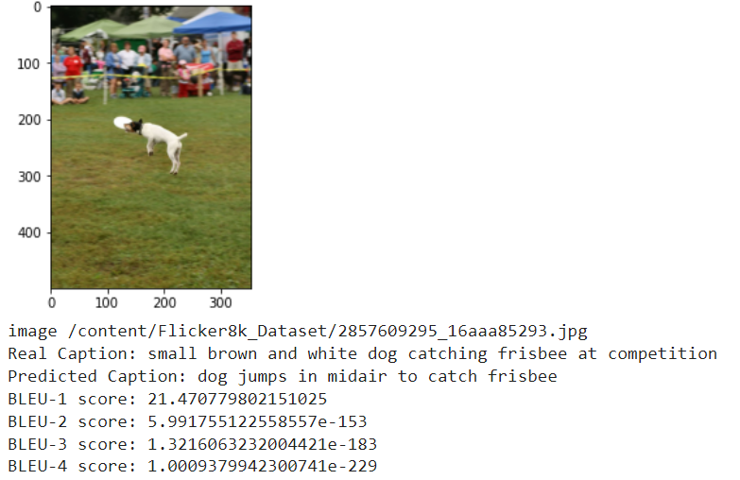
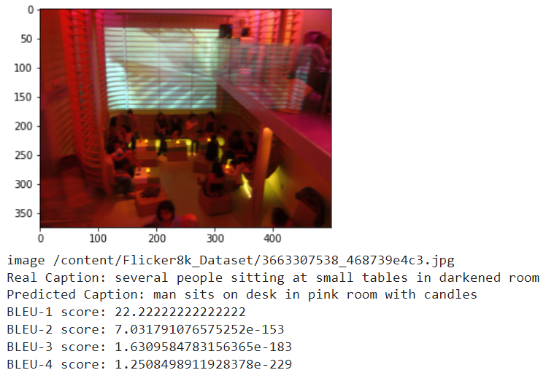
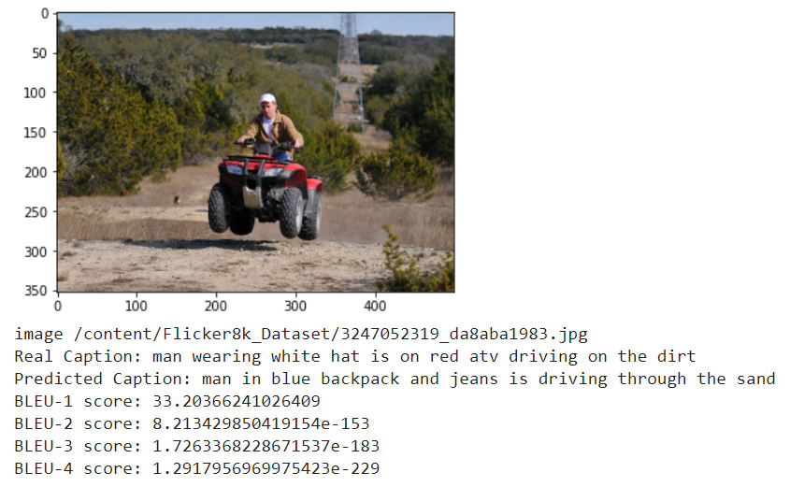
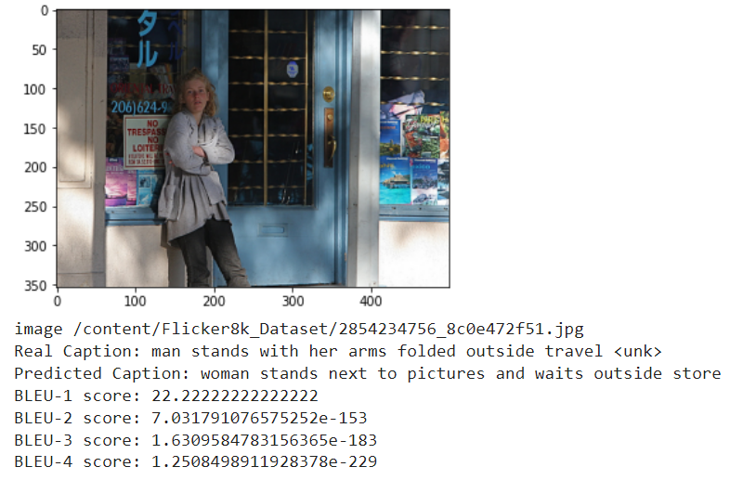
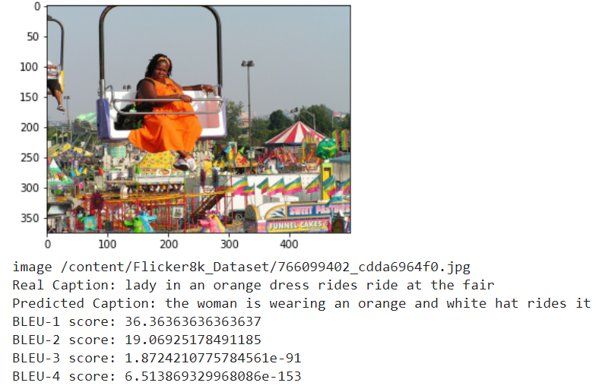
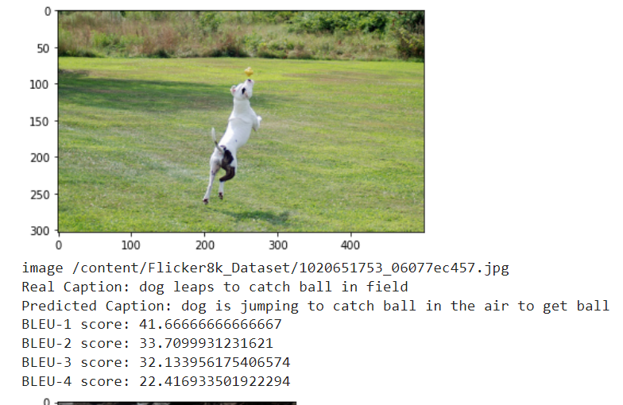
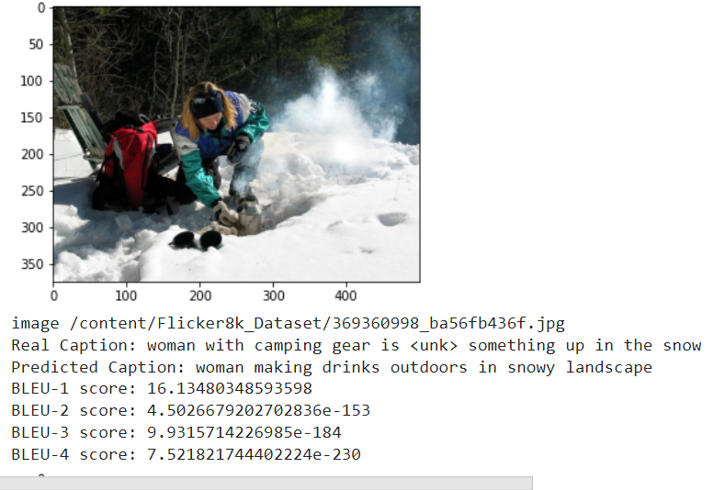
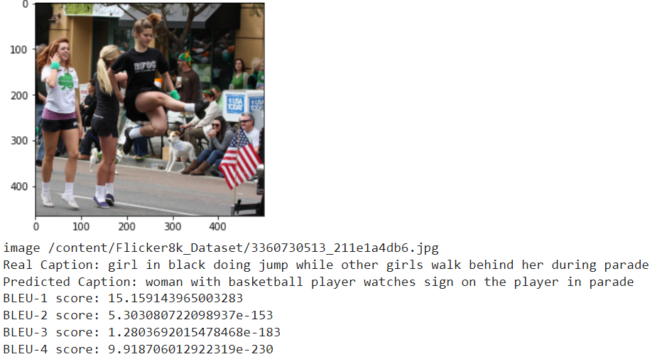
Sample Ouput – Resnet50+70 Epochs + Transformer + Flickr8

Slide 19
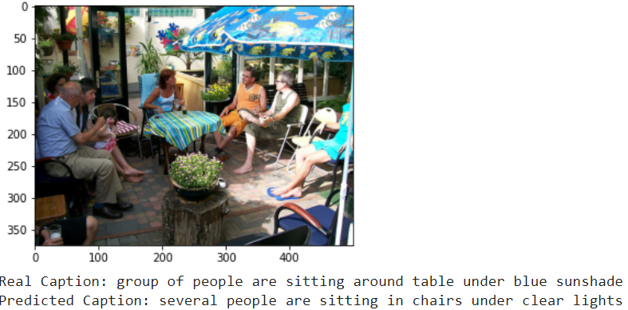
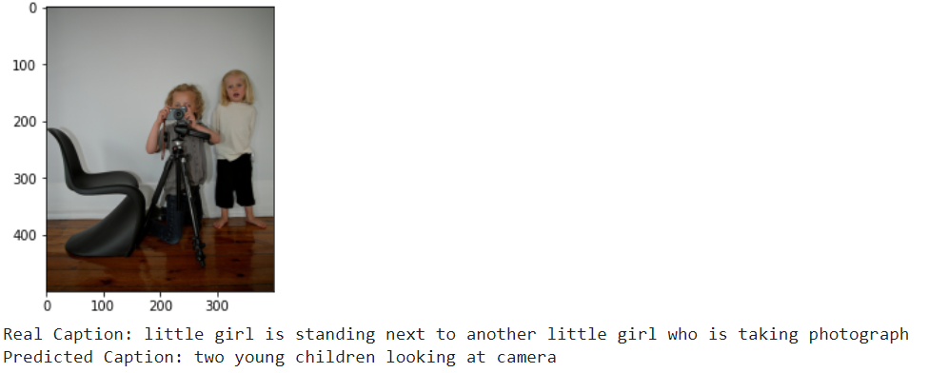
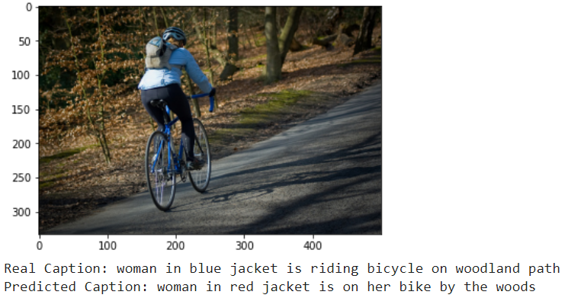
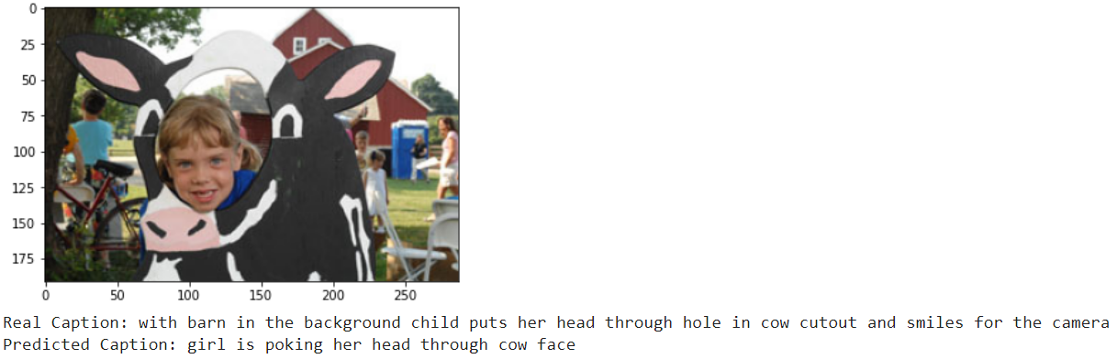
Automated Captions– Transformers- InceptionV3 + Flickr8k

Slide 20
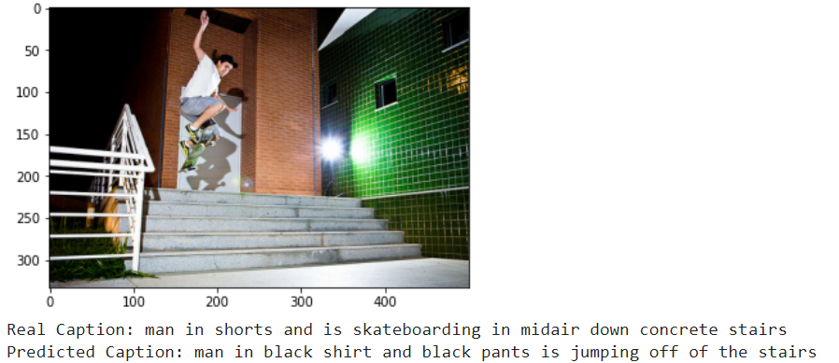
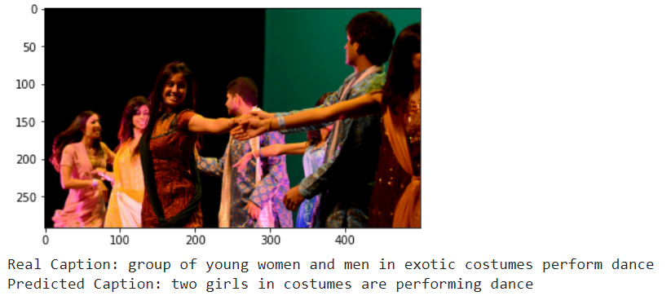
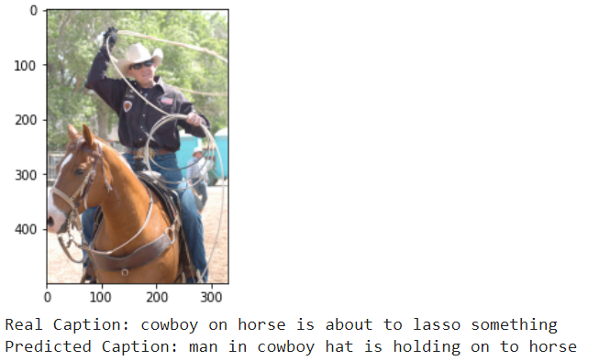
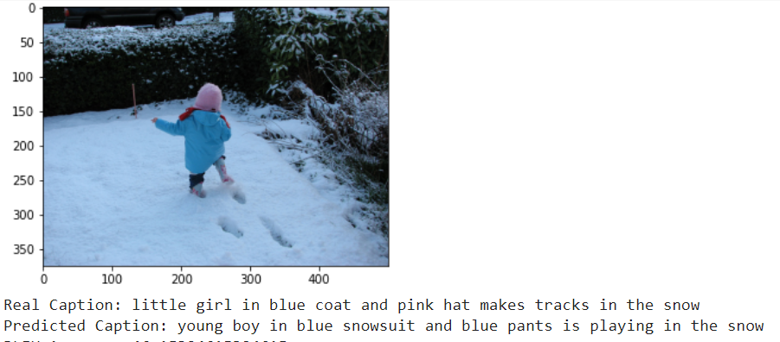
Automated Captions – Transformers – Resnet50 + Flickr30k

Slide 21
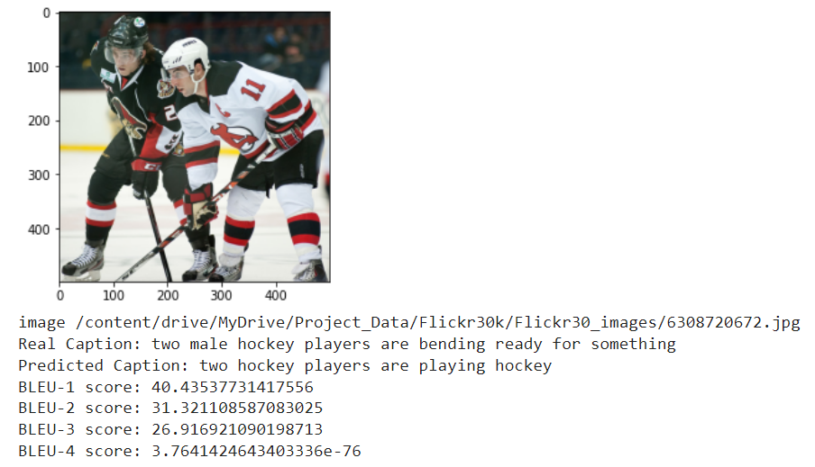
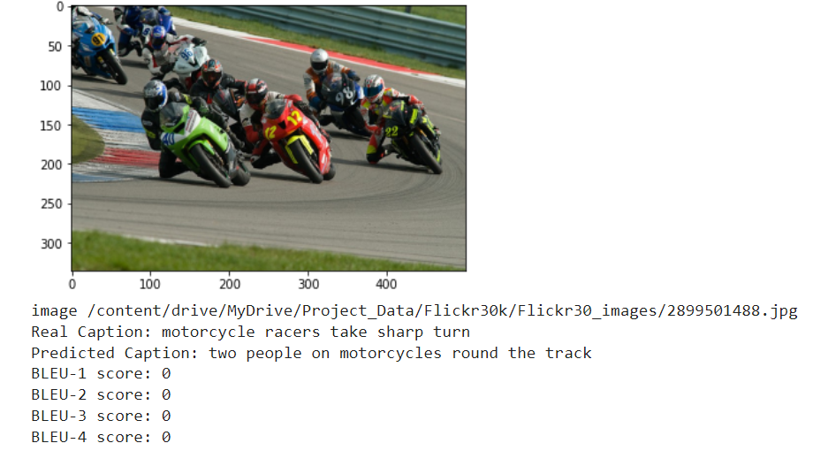
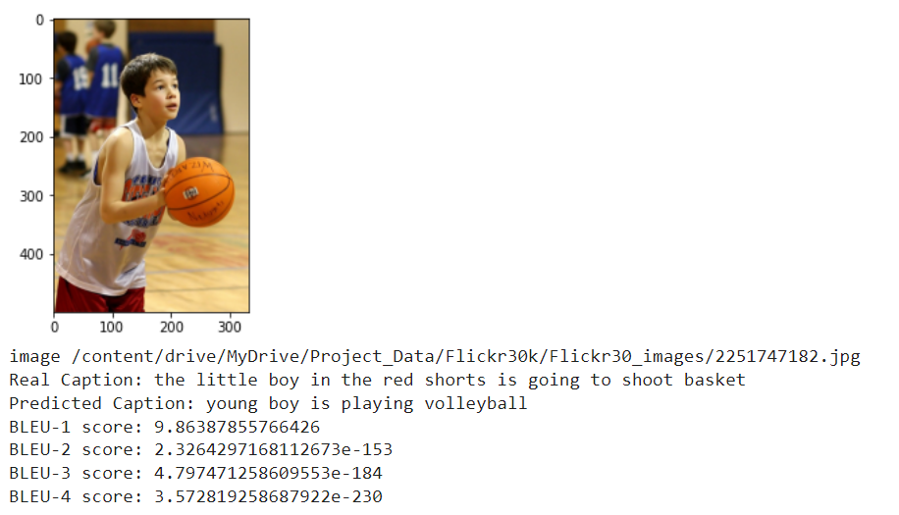
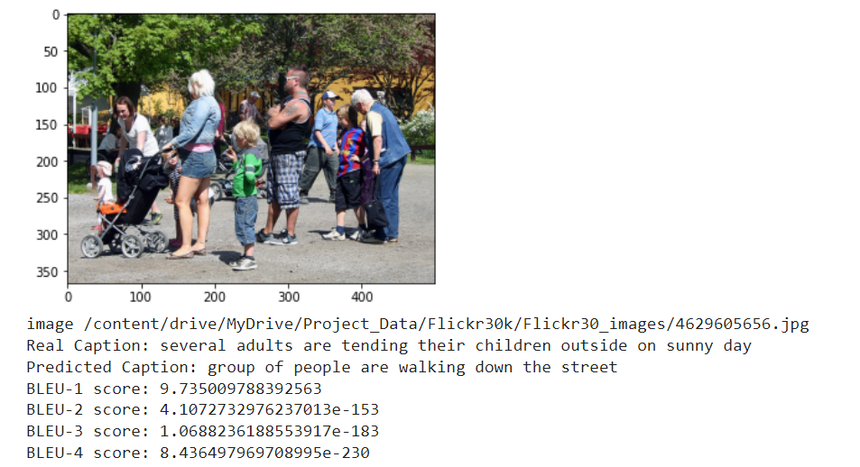
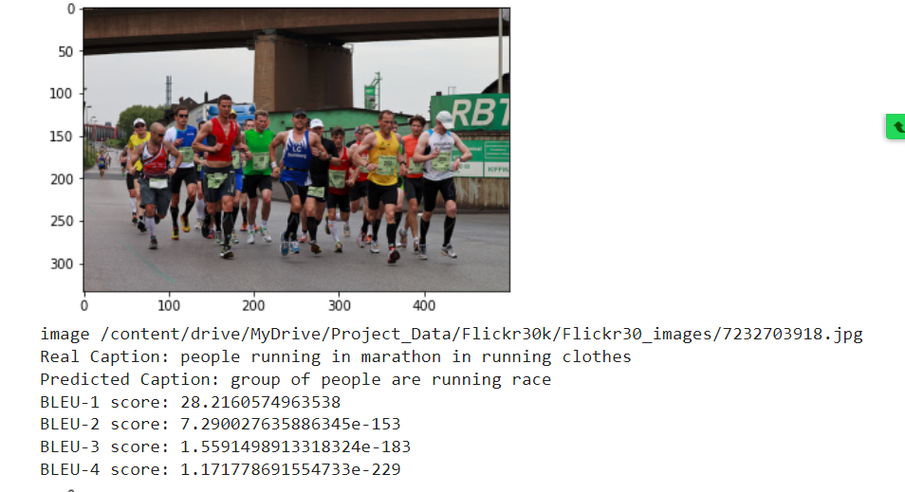
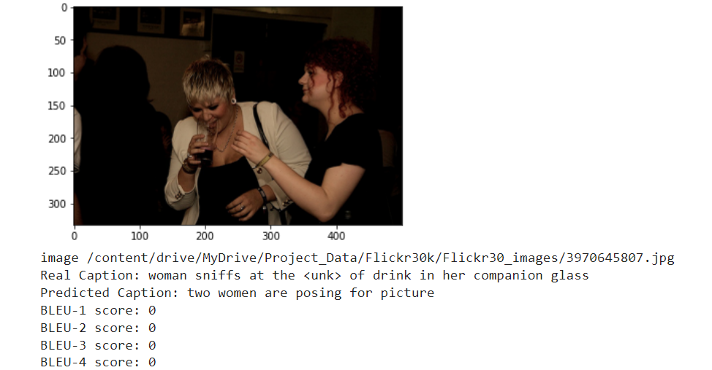
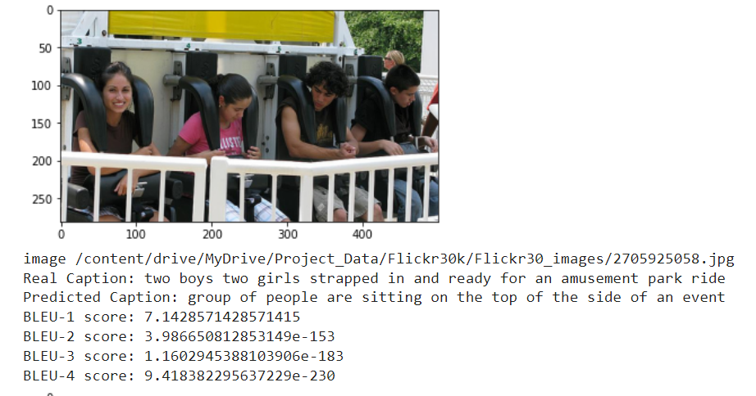



Automated Captions – Transformers – Resnet50 + Flickr30k

Slide 22









Automated Captions – Transformers – Resnet50 + Flickr30k + 45 epochs

Slide 23
Results Snapshot view for various models
Model | Image Feature extraction | Hyper Parameters and training details | Data Set | Results ( Data captured after running on 250 random Test Images)
Base Model - LSTM | Inception V3 | Loss - Cross Entropy Optimizer – Adam Epochs – 45 Learning rate – 0.0001 Training – 8000 images | Flickr8 | BLEU-3 count: 46 | BLEU-3 count average 0.21
 | Resnet50 |  | Flickr8 | BLEU-3 count: 61 | BLEU-3 count average 0.2875
Attention | VGG16 | Loss - SparseCategoricalCrossentropy Optimizer – Adam Epochs – 45 Learning rate – 0.0001 Training – 8000 images | Flickr8 | BLEU-1 count: 176 BLEU-2 count: 71 BLEU-3 count: 26 BLEU-4 count: 4 | BLEU-1 Average: 0.2559 BLEU-2 Average: 0.2275 BLEU-3 Average: 0.2541 BLEU-4 Average: 0.2975
 |  |  | Flickr8/ Flickr30 | BLEU-1 count: 178 BLEU-2 count: 89 BLEU-3 count: 35 BLEU-4 count: 14 | BLEU-1 Average: 0.2773 BLEU-2 Average: 0.2501 BLEU-3 Average: 0.2901 BLEU-4 Average: 0.2608
 | Resnet50 | Loss - Cross Entropy Optimizer – Adam Epochs – 45 Learning rate – 0.0001 | Flickr8 | BLEU-1 count: 178 BLEU-2 count: 89 BLEU-3 count: 35 BLEU-4 count: 14 | BLEU-1 Average: 0.27739 BLEU-2 Average: 0.25019 BLEU-3 Average: 0.29015 BLEU-4 Average: 0.26083
Transformers | Inception V3 | Loss - SparseCategoricalCrossentropy Optimizer – Adam Epochs – 70 Training – 8000 images Multi Head - 8 | Flickr8 | BLEU-1 count: 195 BLEU-2 count: 103 BLEU-3 count: 44 BLEU-4 count: 10 | BLEU-1 Average: 0.3115 BLEU-2 Average: 0.2738 BLEU-3 Average: 0.3011 BLEU-4 Average: 0.2824
 | Resnet50 |  | Flickr8 | BLEU-1 count: 200 BLEU-2 count: 100 BLEU-3 count: 40 BLEU-4 count: 12 | BLEU-1 Average: 0.2679 BLEU-2 Average: 0.2412 BLEU-3 Average: 0.2981 BLEU-4 Average: 0.3194
 | Resnet50 | Loss - SparseCategoricalCrossentropy Optimizer – Adam Epochs – 35 Training – 25000 images Multi Head – 8 | Flickr30 | BLEU-1 count: 177 BLEU-2 count: 52 BLEU-3 count: 26 BLEU-4 count: 7 | BLEU-1 Average: 0.2360 BLEU-2 Average: 0.2381 BLEU-3 Average: 0.2709 BLEU-4 Average: 0.3358
BLEU-1 Average: 0.2527
BLEU-2 Average: 0.2550
BLEU-3 Average: 0.2908
BLEU-4 Average: 0.2751

Slide 24
Deployment model
Model generation
Fast API & UI Integration
Google Cloud Integration
1)Create application in Google cloud and install Cloud SDK
2)Open command prompt on local machine and enter below commands:
cd C:\Model Deployment\deploy_aic_lstm-main
gcloud init --it sets your gmail
gcloud config get-value project
gcloud builds submit --tag gcr.io/deploy-aic-lstm/aiclstm --deploy-aic-lstm is project id created in cloud and aiclstm is service name we intend to give
3)Got to Gcloud UI
->cloud run
->Create service aiclstm and enter details
Train model and save weights in Colab notebook for
LSTM
Attention
Transformer
Save Encoded Tokenizer model
Create FAST API App with reference to specific model like LSTM , Attention and Transformer
Build a python file which replicates the model in the colab
Build HTML to take Image input and retrieve captions
Build and deploy on Google Cloud using the input from the Fast API
Set the configuration to 2GB
Models trained on Flickr8 and Flickr30
Tokenizer file created on captions provided with Flickr8 and Flickr30
Models from Colab are integrated and executed locally
Docker file from Fast API implementation , HTML , Configuration , Support Functions , Start

Slide 25
Demo

Slide 26






Caption Generation – UI Integration (Fast API and GCP) + Transformer + Flickr30k

Slide 27






Caption Generation – UI Integration (Fast API and GCP) + Transformer + Flickr 8k

Slide 28
Challenges and mitigation
Challenge | Description | Mitigation
Flickr30k data set processing | Flickr30K is of size 4G The number of files and size created an issue with processing while training the models | Downloaded the image files on Google drive Build the Numpy files from Pretrained Resnet50 on Google drive Incrementally move the Numpy files to Collab and while training and execution
Processing Multiple epochs for Flickr30K | Flickr30K is of size 4G The number of files and size created an issue with processing while training the models Performance of training- Each epoch runs ~10 min | Train the models incrementally for 10-15 epoch at time and build save the weights Start the next training with from previous training end point by loading saved weights
Evaluation of captions using Bleu score | Improving evaluation criteria of Bleu score for the captions | Blues score were calculated for Single , Bi gram, Tri gram and N Grams for values >0.1 and averages across all the caption generation for Test images
Transformers Implementation | Additional MHA for Word embedding(captions) was part of the model which had to be removed from traditional approach of transformer implementation | Captions were created processed only for Word embedding + Positional encoding and directly passed to Encoder decoder MHA block
Integration with Fast API /Cloud | Limitation in Heroku for 512 Tensorflow models need high configuration (> 1GB RAM) | To deploy on GCP Cloud Give higher configuration to deploy on cloud
Github upload for huge files( >25 MB) | More than 25 MB files were not opening on github | Deployed github lfs and uploaded files

Slide 29
Inference
We used the Blue Score data for multiple combinations Architecture + Data sets and we inferred that Transformers + Multi Head Attention which is trained on Flickr30K image set gave the best results both with Blue score and some random test images.
Category | LSTM | Attention + LSTM | Transformers
Processing | Sequential | Sequential | Parallel Processing
Dataset Requirement | Small to Medium | Large | Large
Weights to be trained | Low | Medium | High
Accuracy(Bleu score Avg) | 0.2875 | 0.2751 | 0.3358
Deployment | Less CPU | Higher Configuration Memory/CPU | Higher Configuration Memory/GPU
Computation | Low | Medium | High
Potential shortfalls | Bias added due to data set Size of image date set should be large for better training accuracy Size of vocabulary the captions cover should be higher Vocabulary or Caption style in learning data could be very subjective to expert style | Bias added due to data set Size of image date set should be large for better training accuracy Size of vocabulary the captions cover should be higher Vocabulary or Caption style in learning data could be very subjective to expert style | Bias added due to data set Size of image date set should be large for better training accuracy Size of vocabulary the captions cover should be higher Vocabulary or Caption style in learning data could be very subjective to expert style

Slide 30
Real Life applications
Virtual assistants
Image indexing
Helping visually impaired persons
Natural language processing applications

Slide 31
Thank You!!

Slide 32




Model - LSTM
Input gate
LSTM Gates
Forget gate
Output gate
Word prediction
Context
Probability
Image Vector from CNN
End to End
Word Embedding
Loss function

Slide 33
Architecture – Keras Implementation
inputs1 = Input(shape=(2048,))
fe1 = Dropout(0.5)(inputs1)
fe2 = Dense(256, activation='relu')(fe1)
inputs2 = Input(shape=(max_length,))
se1 = Embedding(vocab_size, embedding_dim, mask_zero=True)(inputs2)
se2 = Dropout(0.5)(se1)
se3 = LSTM(256)(se2)
decoder1 = add([fe2, se3])
decoder2 = Dense(256, activation='relu')(decoder1)
outputs = Dense(vocab_size, activation='softmax')(decoder2)
model = Model(inputs=[inputs1, inputs2], outputs=outputs)

